Slide 1
Model View Controller (MVC) Design Pattern
By James Moran
Notes:
Hello and welcome to this presentation on the Model View Controller Pattern (MVC). I, James Moran, will be giving this presentation, let’s begin.

Slide 2
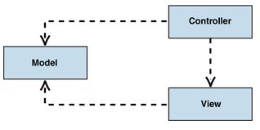
What is the MVC?
MVC Overview
Model
View
Controller
(Microsoft, © 2018a)
MVC Class Structure Diagram
(Microsoft, © 2018b)
Notes:
What is the MVC? It separates modelling of the logical-framework, visual-presentation and handling user-input, into three separate design aspects for a project. The Model handles the business-logic of the application, responding to requests for information from the View, given the current state, as well as any commands to change state (such as the user clicking on a button in the View), from the Controller. The View is the visual aspect for the application, in the case of the Game Café, showing a form with various controls, that show information to the user, garnered from the Model (such as Membership Information) and allow traversal through the application (via form navigation buttons, to access a certain part of the system).

Slide 3
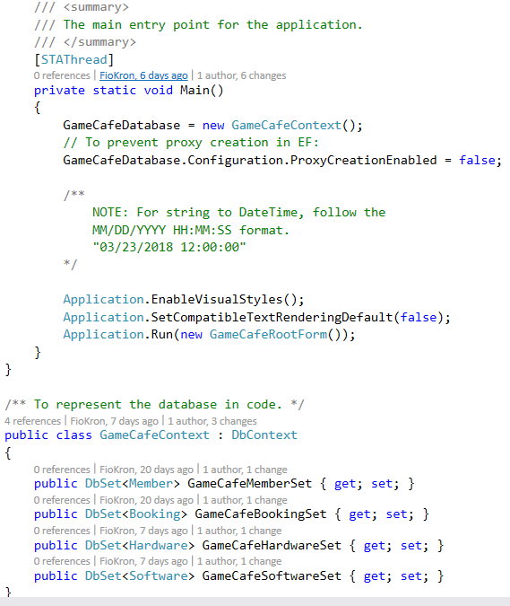
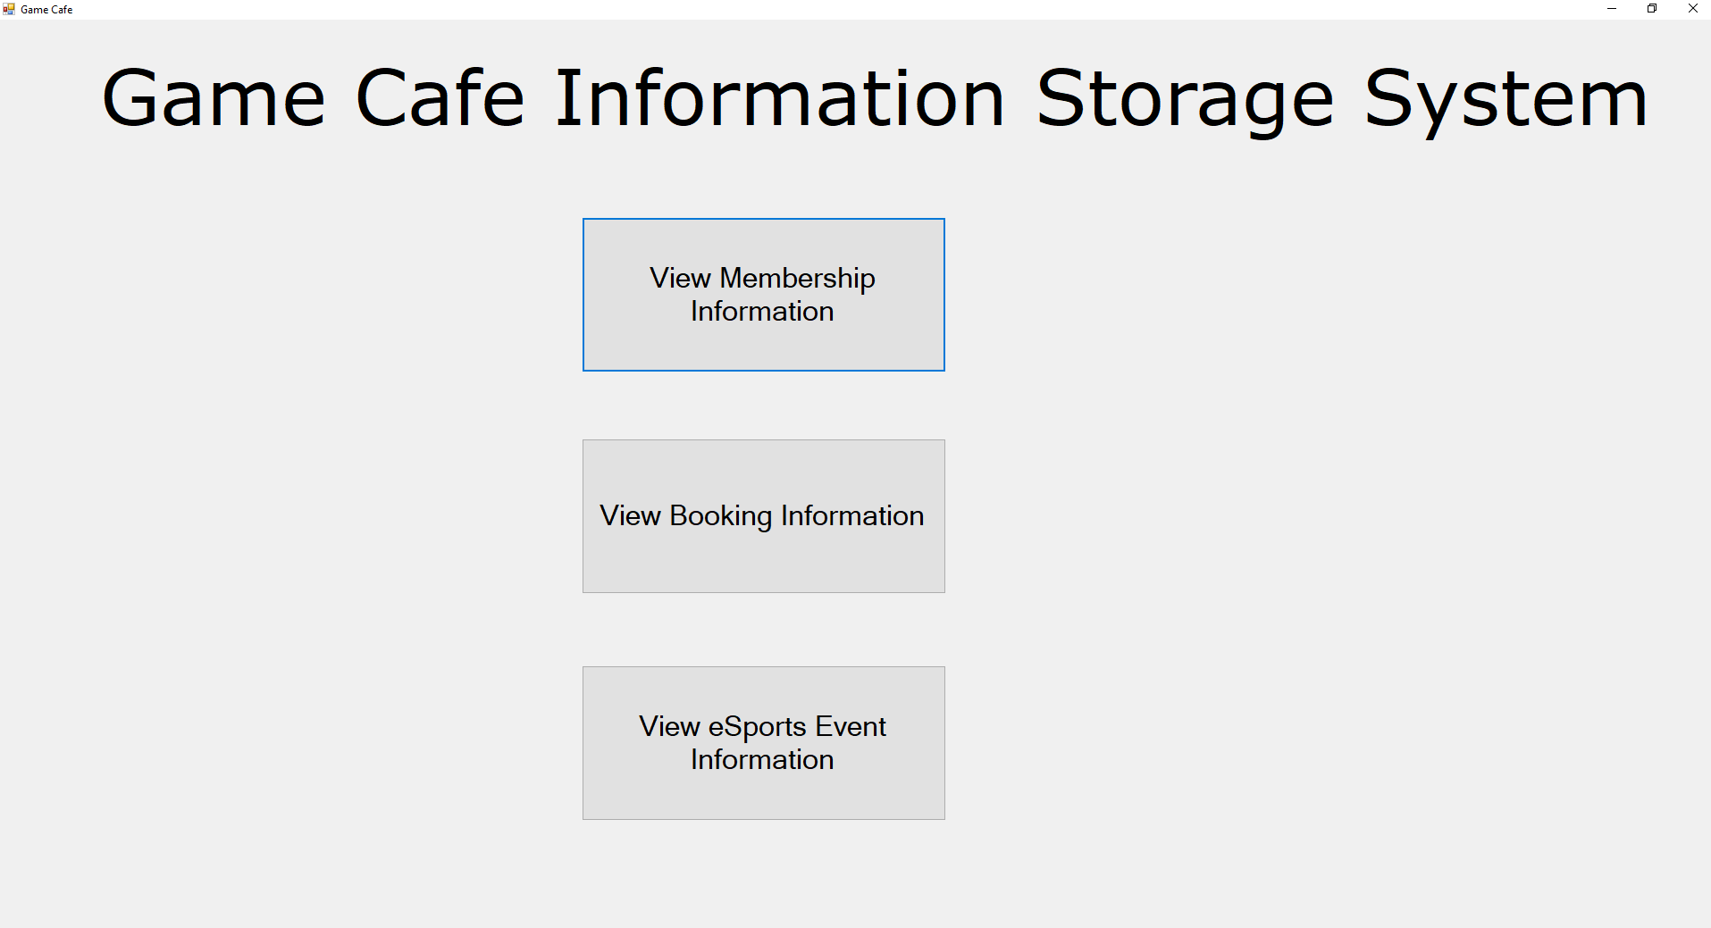
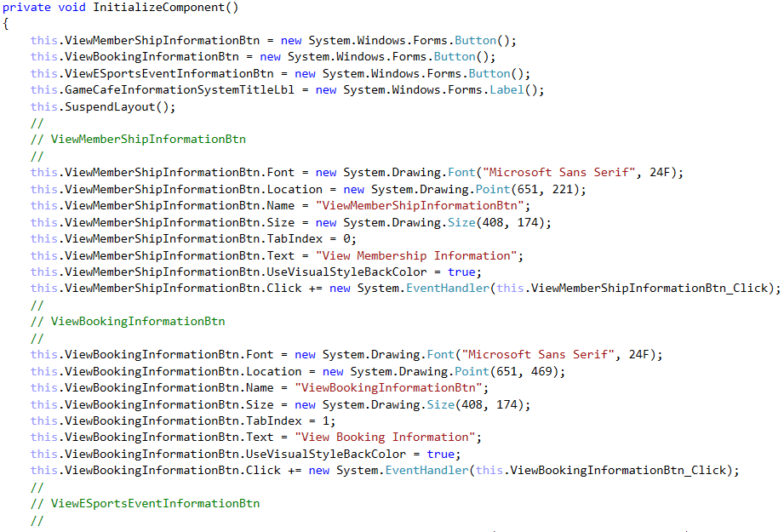
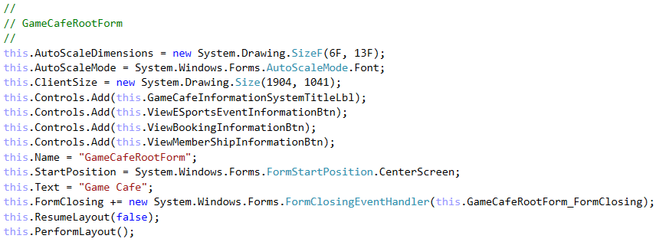
Usage in the Game Café
Model
View
Controller
Notes:
Considering the Game Café as an example, the Model is initiated via the main entry-point into the application (initialising the root-form of the system), as well as having a representation of the Database and its tables, for the information that is stored about certain aspects of the Game Café (e.g. for Members, Bookings and Hardware available at the Game Café). These are represented as classes in the application, with the details in respect to the class name, stored in the class, along with another class (IDUpdateSystem), to handle updating the ID for each of these classes, whenever a new entry is added to the database. Next comes the View of the system, with the example of the GameCafeRootForm shown here, that is displayed to the User, to allow them to interact with the system (in this case, there is a title and three buttons that allow them to traverse to the form for viewing the respective Member, Booking or eSports Event Information on that form). This leads into the Controller design-aspect, with the logic for the form visual-aspect, being auto-generated by Visual Studio, along with event-handlers for certain controls on this form, (e.g. for when any button on the form is pressed), as well as event-handlers for the form itself (such as when the form is closing). The logic for these events, is contained within a class for the form (with the same name as the form), for what occurs when these events are raised (whether that is hiding the root form and showing another form or checking to see if the User is closing this form, asking them to confirm their choice).

Slide 4
Advantages and Disadvantages of the MVC Pattern
Advantages
Supports Multiple Views
Accommodates Change
Disadvantages
Complexity
Cost of Frequent Updates
(Microsoft, © 2018c)
Notes:
Advantages and disadvantages of the MVC Design-Pattern, are detailed here, with the Advantages being that of Supporting Multiple Views (allowing the user to change the appearance of the system’s forms, as the view is separated from the Model) and Accommodating for Change (most notably, that of changing User-Interface Requirements, for if the User wants to view the application on another device). The potential disadvantages are that of Complexity (introducing new levels of indirection to the project, as well as taking into account the Event-Driven systems for User-Interface code, which can become more difficult to debug) and the Cost of Frequent Updates (even with decoupling between the Model and the View, as the developers of the Model should at least consider the View, when making changes to the system Model).

Slide 5

References
MICROSOFT, © 2018a. Model-View-Controller [Viewed on the 27/03/2018]. Available from: https://msdn.microsoft.com/en-us/library/ff649643.aspx
MICROSOFT, © 2018b. MVC class structure [Digital Image] [Viewed on the 27/03/2018]. Available from: https://msdn.microsoft.com/en-us/library/ff649643.aspx (Figure 1: IC114765.gif)
MICROSOFT, © 2018c. Model-View-Controller (Resulting Context Header)[Viewed on the 27/03/2018]. Available from: https://msdn.microsoft.com/en-us/library/ff649643.aspx
Notes:
This slide details the references used in this presentation, thank-you for taking the time to watch this presentation and goodbye for now.

